Slide 1
ASP.NET MVC
Learning agreements

Slide 2
ASP.NET MVC
3 credits → 75h of jobload
5 weeks for 9 chapters
3 course blocks weekly
1+2 :theory
3 :exercising & coaching
17/2 | Lesson 1: Introduction ASP.NET MVC
24/2 (APP/AI) or 25/2 (ACS) | Lesson 2: EF Core Lesson 3: Reading Data
3/3 | Lesson 4: Writing Data Lesson 5: ViewModels
10/3 | Lesson 6: Security Lesson 7: Scaffolding part 1
17/3 | International days (no classes)
24/3 | Lesson 7: Scaffolding part 2 Lesson 8: Sessions & Migrations Lesson 9: Components

Slide 3
Evaluation
June
Practical exam on own device
Course material can be used
The exam is open internet but any form of collaboration between students is considered exam fraud.
August (2nd chance)
This course unit does not allow partial mark transfers
Same modality as 1st examination chance

Slide 4
Lecturers
Michaël Cloots
Ellen Torfs
Koen Vangeel

Slide 5
Quarantine?
Michaël Cloots’s lesson(s) can be followed online (see Teams link on Canvas)
Please note that the classes are NOT recorded!

Slide 6
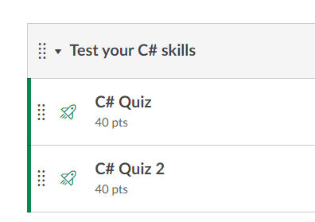
Prerequisites
Knowledge of the C# programming language is required → see course Devops & Security
You can test your C# skills by taking the quizzes available on canvas
You should achieve a mininum score of 75%

